Slide 1
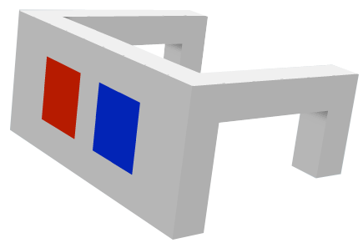
A BRIEF INTRODUCTION TO 3D
Selected topics with focus on Flash, Unity and WebGL
Notes:
Welcome to a session a have chosen to call ”a brief introduction to 3D”. It’s around 100 slides or three hours if listening to me talking about them. I have tried to filter some topics that may be interesting from a flash-developers point of view. If you are a ”online” guest, I have tried to fill in with some comments for you, but this was intended as a discussion base rather than a online guide, so keywords is the main thing.
I also want to give credits for all of you that has contributed to this presentation by publishing papers, tutorials and demos. There is some copy-n-paste going on occasionally and I have lost track of all references and sources. Loads of credits goes out to you all.
Lets start!

Slide 2
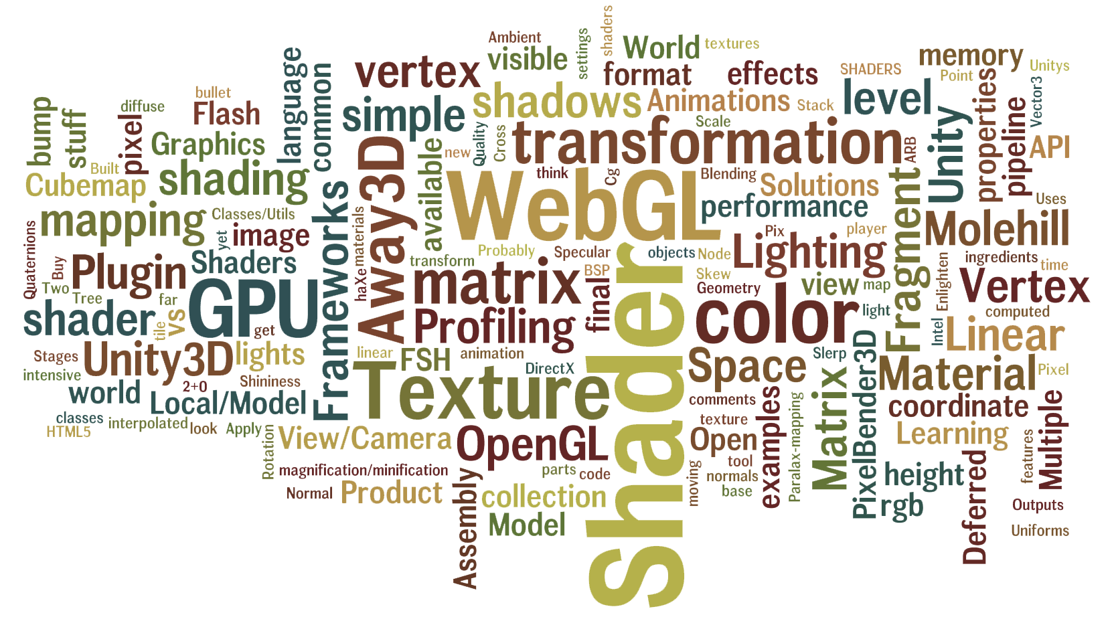
Notes:
Some of the topics of this talk

Slide 3
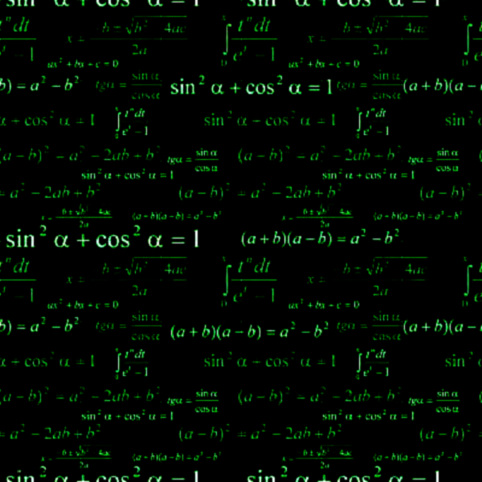
MATH & ALGEBRA
Notes:
Get familiar with the basics. You don’t necessarily have to know the math behind the solutions, but by learning the basics you learn how to formulate the solution and find it quickly.

Slide 4

VECTOR
Notes:
Vector! That’s me, because I'm committing crime with both direction and magnitude. OH YEAH!!!
Points and Vectors, essential gemometric objects when dealing with 3D. I will shortly mention the most basic operations that you probable while working with a 3D-framework. Also note that when dealing with 3D the vectors used to be normalized, a value between 0-1.
Also, don’t confuse the geometric object ”Vector” with the Flash datatype Vector<int>. That is a typed Array. Vectors in flash is named Vector3D.
Some links:
http://www.nondot.org/sabre/graphpro/3d2.html
http://programmedlessons.org/VectorLessons/vectorIndex.html

Slide 5
Length
Pythagorean Formula
|V| = sqrt(x² + y²)
Notes:
The length between two points, or in this case the length of a Vector if you travel from the tail to the head.
To calculate in 3D, just add an extra term.

Slide 6
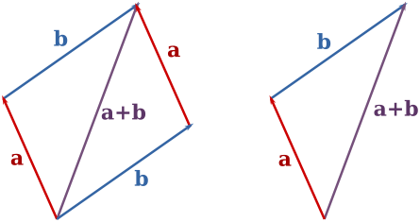
Addition
A = (1, 2)
B = (4, 0)
A + B = (1+4, 2+0) = (5, 2)
Notes:
To find out where the sum of some vector is located.
To add it graphically, you put the tail of one vector at the head of the other.
Just like scalar addition, the order that you add the vectors does not matter.
To calculate in 3d, just add an extra term.

Slide 7
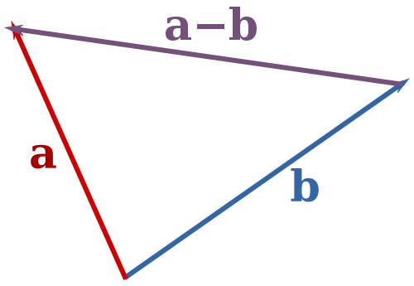
Subtraction
A = (1, 2)
B = (4, 0)
A - B = A + (-B)
A - B = (1-4, 2-0) = (-3, 2)
Notes:
To find the magnitude and direction of the difference between two vectors
Subtracting vectors is very much the same as adding them, except that you do it in the opposite order.
Negating a vector is a simple as rotating it 180 degrees.
To calculate in 3d, just add an extra term.

Slide 8
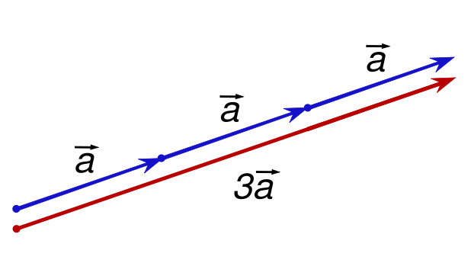
Scalar Multiplication
A*3 = (3*1, 3*2) = (3, 6)
(unit vector = divide the vector by it's length)
Notes:
This operation scales vectors, like stretching or shrinking a vector.
Scalar = a single real number
unit vector = normalized vector

Slide 9
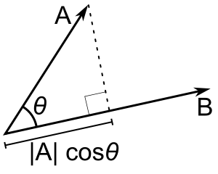
Dot Product
A = (A_{x}, A_{y}, A_{z}) B = (B_{x}, B_{y}, B_{z})
A·B = A_{x}B_{x} + A_{y}B_{y} + A_{z}B_{z} A·B = |A||B|cosθ
Notes:
The Dot Product is a vector operation which will return a scalar value (single number), which for unit vectors is equal to the cosine of the angle between the two input vectors.
Finding the angle between two vectors.
Also called “Inner product”.
Backface culling
Light surfaces
Also with the dot product, you can find the length of a projection of one vector on another.

Slide 10
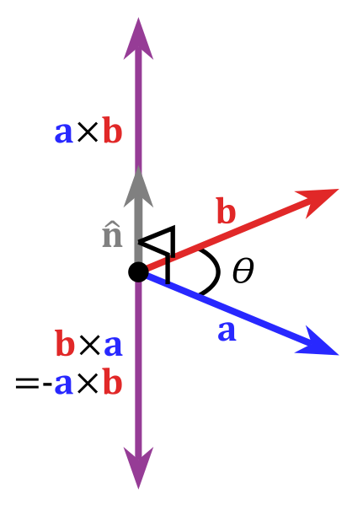
Cross Product
AxB = (A_{y}B_{z} - A_{z}B_{y}, A_{z}B_{x} - A_{x}B_{z}, A_{x}B_{y} - A_{y}B_{x})
Notes:
Find the normal vector of a plane. It’s a more advanced operation, but very useful.
Used to calculate the normal vector. The normal vector to a plane is the one that sticks straight out of it. Useful for things like shading the surface and determining visibility.

Slide 11
Real world examples
In which direction should the missile be fired to hit the target?
Is the enemy visible in the field of view?
How far is the bullet from the window?
Notes:
It’s easier to get the concept by formulate real world examples.

Slide 12



Solutions
Solutions have been done by many before.
Know the basics to find them quicker.
Use utils and classes like:
Vector3D
Vector3DUtils
Plane3D, Ray (4.0)
Vector3
Notes:
Don’t panic. You probably will get away with little knowledge about this, but only to a certain level.

Slide 13
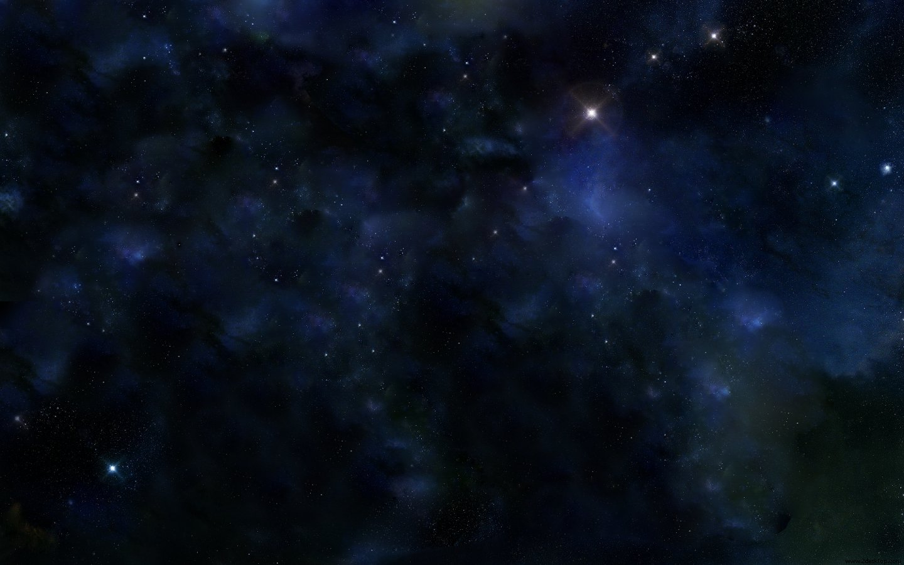
SPACES
Notes:
Feel the space in your 3d world. When thinking on a point or a vector, or when transforming and rotating objects, picturize the space to get an understanding of the directions and how axis is pointing.

Slide 14
Spaces
Euclidean space using Cartesian coordinates. (X, Y and Z)
Local/Model Space
World Space
View/Camera Space (Point-of-view)
Screen space (2D)
Notes:
We are using some different spaces depending on where we looking from.
Object space: Local to an object, an object being a set of polygons. If you want to have multiple instances of the same object, at different locations in the world, you need object space.
World space: This coordinate system is the most important one. This is where all objects are positioned, where you do compute physics, movements and collisions detection. It is also here that lighting is computed. Think of the world space as your game world.
View space: This coordinate system is relative to the camera. Objects in world space are transformed to view space to know what is visible on the screen. This space is also commonly called "eye space" or "camera space".
Screen space (2D): Coordinates representation of the screen. Coordinates are not pixels though. The viewport maps view space to screen space, and the origin in screen space is in the middle of the screen (for perspective projections anyway).

Slide 15
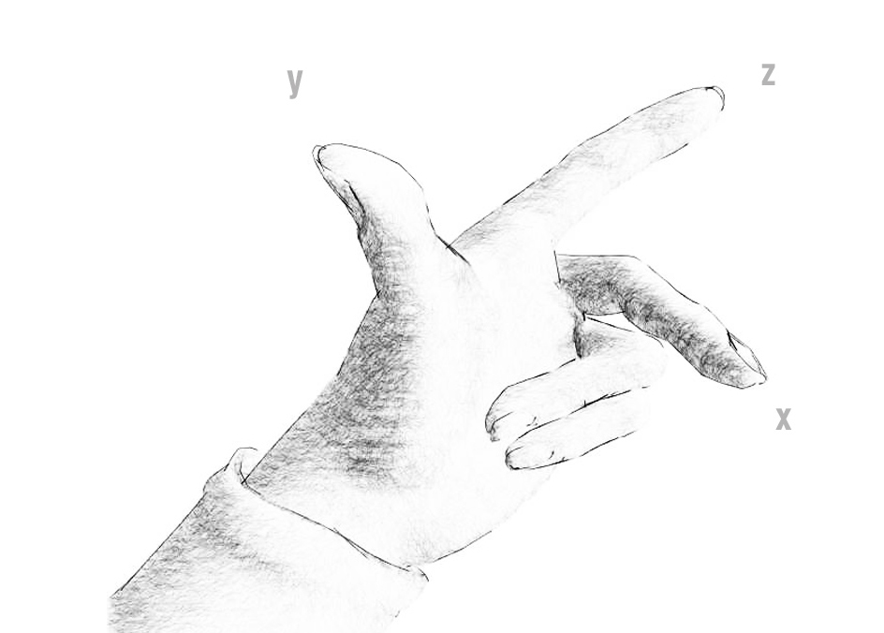
Left- and right-handed systems
Notes:
There is two kinds, the left- or the right-handed system. This can be a little tricky when importing/exporting between softwares. 3DS Max has a left-handed system (Z up Y into the screen and X right) while Maya and Unity for example, uses a right handed. That is because OpenGL and Direct3D vary in axis system.
The picture above representing the left handed one. To use the right-handed one, rotate your right hand 180 degrees around your thumb (y), so that you are pointing at yourself. (inverts z-axis).

Slide 16
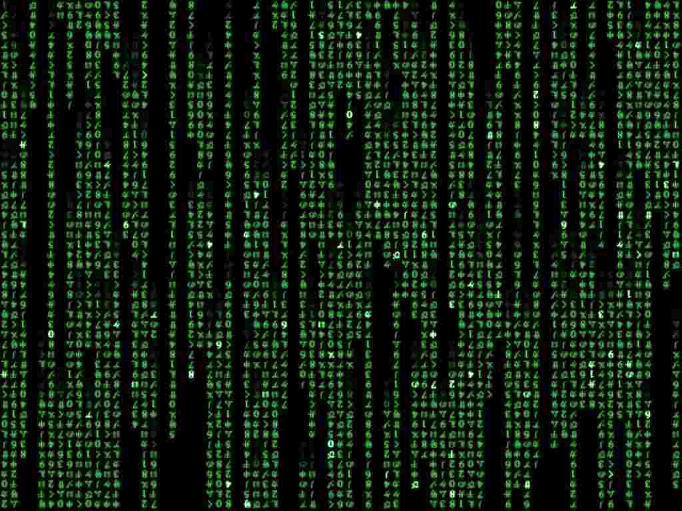
MATRICES AND SPACES
ENTER THE MATRIX
Notes:
Enter the Matrix. For the untrained eye it’s just a bunch of numbers in a grid, but when/if you learn it you see a world full of transformations.

Slide 17
Matrices
Matrix = Transformation placeholder
So again:
Local/Model matrix
World matrix
View/Camera matrix
WVP = world * view * projection
Notes:
Lets repeat
local/model matrix: contains all the necessary translation, rotation, skewing, scaling, etc. information. A model matrix represents the sum total of the data necessary to orient the object correctly in local space. world matrix: contains all the necessary information to orient the object in world space. view matrix: is used to push the world matrices into view space or camera space.
An excellent in depth explanation can be found here: http://db-in.com/blog/2011/04/cameras-on-opengl-es-2-x/
WVP matrix: world * view * projection. Worth mentioning because you will probably stumble upon this and other pre-concatenated matrices in vertex shaders.

Slide 18
Classes/Utils
Matrix3D
Matrix3DUtils
Matrix4x4
Notes:
Just some classes to use when dealing with matrices.

Slide 19
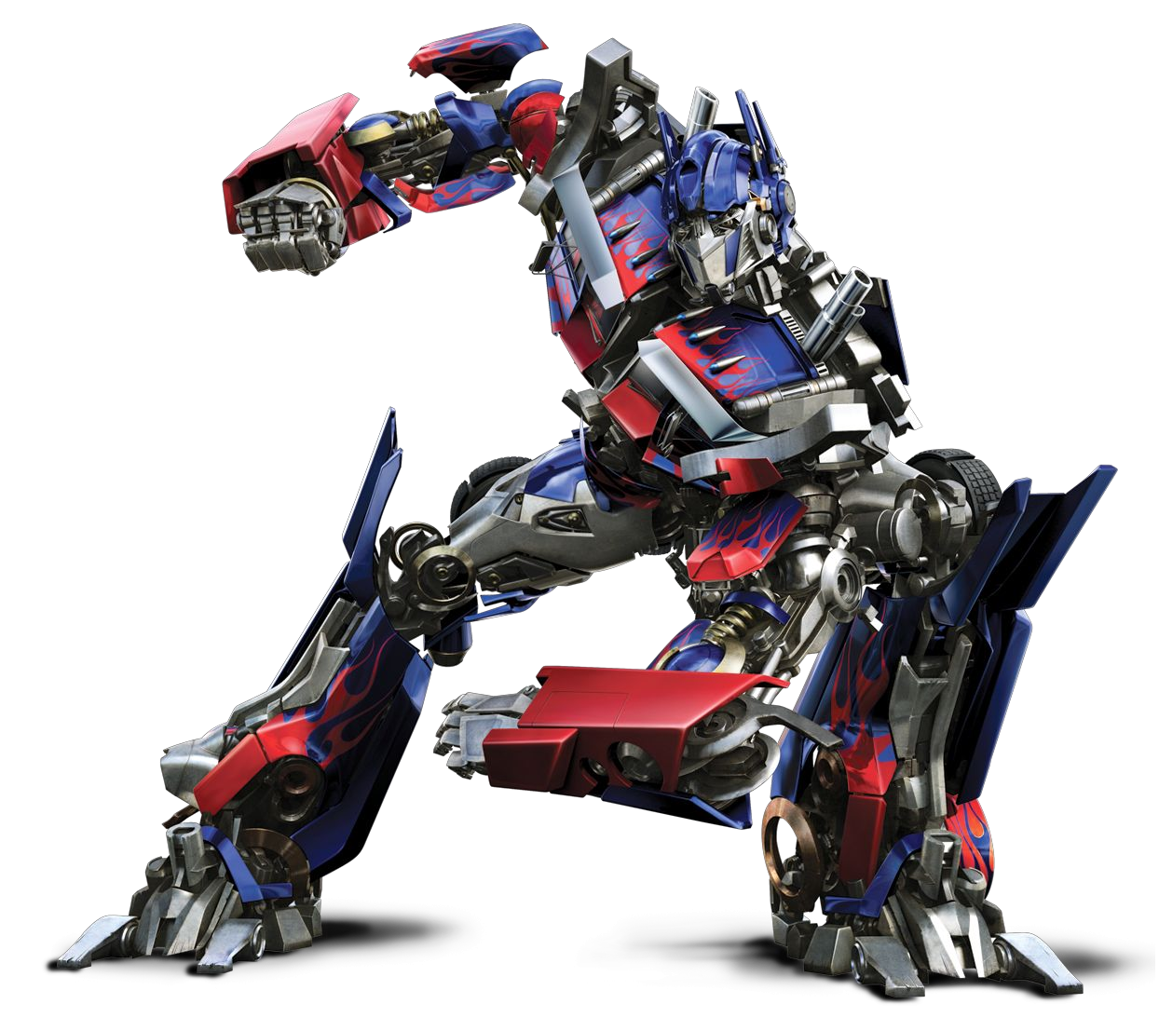
TRANSFORMATIONS
Notes:
Transformation = A geometric operation applied to all the points of an object.

Slide 20

Linear transformation
Translation
Notes:
An other word for moving an object.

Slide 21

Linear transformation
Scale
Notes:
Ehh... Scale...

Slide 22

Linear transformation
Skew
Notes:
WTF, why did I render these illustrations? Everybody knows what scale and skew is right? Anyway, graphics is a little funnier to look at. Teapots FTW.

Slide 23
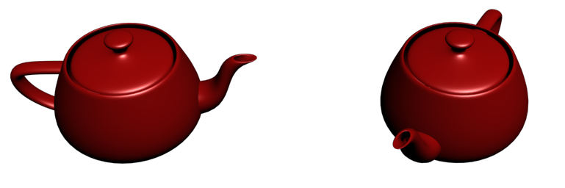
Linear transformation
Rotation
Eulers
Quaternions
Avoids gimbal lock
Slerp (Smooth interpolated rotation)
Matrix – memory intensive
Notes:
There is some different techniques to rotate an object in 3d space. Each of these could have their own section in this document, but we have a lot to talk about so feel free to go wild on Wikipedia later on.
Euler angles are rotation angles relative to the space above the selected object ( x, y and z axis).
Not all euler values are a unique rotation. It's valid to have a rotation of 10000 degress. Can cause weird animations.
Be careful in the order you apply them, because you can end up in a situation called of "gimbal lock“.
Gimbal lock: Brings one of the axis to match with another and the result of the rotation isn't what you meant to obtain. (Rotate "X" by 90 degrees and you get "Y." Specify a 90-degree rotation of "X" and some rotation of "Y")
Quaternions: Define an vector and rotate around that axis. Simple to use. Great for animations from one direction to another.
Matrix: The problem with matrices is that they are memory hogs and matrix math is fairly memory intensive.
http://db-in.com/blog/2011/04/cameras-on-opengl-es-2-x/

Slide 24
Multi linear transformation
Stack of matrices
Apply all at once to an object
The order is importent
Identity matrix
Notes:
A ordered stack of matrices sums up to a single matrix. Initial transformation is called “identity-matrix”. You can also inverse matrices, useful when moving between spaces.
Once again, a good read: http://db-in.com/blog/2011/04/cameras-on-opengl-es-2-x/#matrices

Slide 25
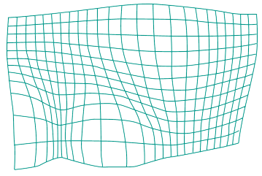
Nonlinear transformations
Sin curve displacement
Warp
Notes:
Sin/Cos curve to displace vertices between camera and screen transformation matrix. e.g Water effect in Quake 1.

Slide 26

PROJECTIONS
Converting a three-dimensional graphics object
or scene into two dimensions

Slide 27
Most common projections
Perspective
Objects is smaller further away
Projection lines meet at center of projections (the vanish-point).
Frustum
Ortographic
Parallell lines never meet
Isometric , Architechtual blueprints
No vanish-point.
Notes:
You have the choice of looking at your amazing 3d world in two different ways. Its basically a matrix that transforms the data from 3D space to 2D space, projecting the vertices to a 2D plane. In this step we also want to transform the data into normalized coordinates [-1, 1] for further process to screen coordinates. By doing that it is easier to scale the values to the right output size. Note though that the original data is still in the same place, see the transformation as a filter infront of our world.
http://www.songho.ca/opengl/gl_projectionmatrix.html

Slide 28
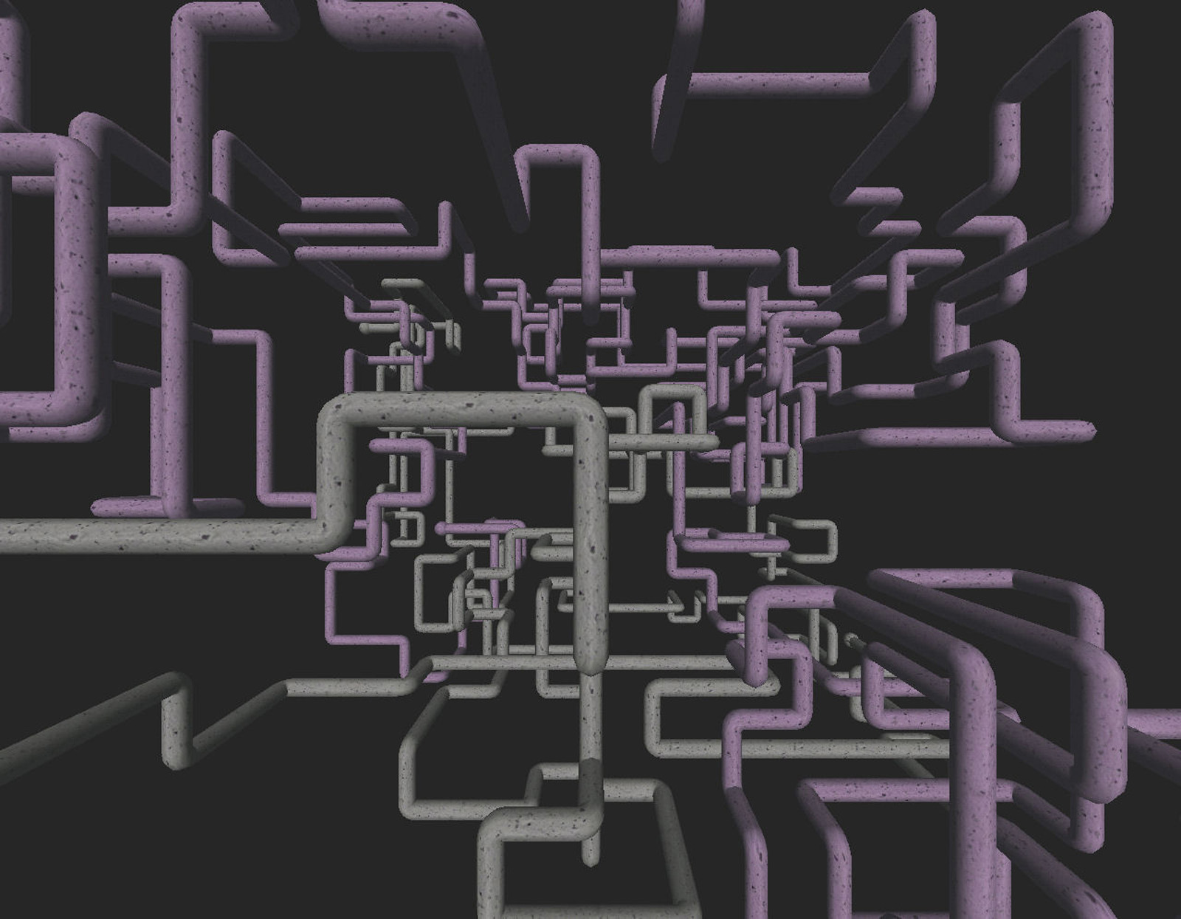
GRAPHICS PIPELINE
Notes:
Let’s have a look at the graphics pipeline. An understanding of how it works makes you wanna tweak it.

Slide 29
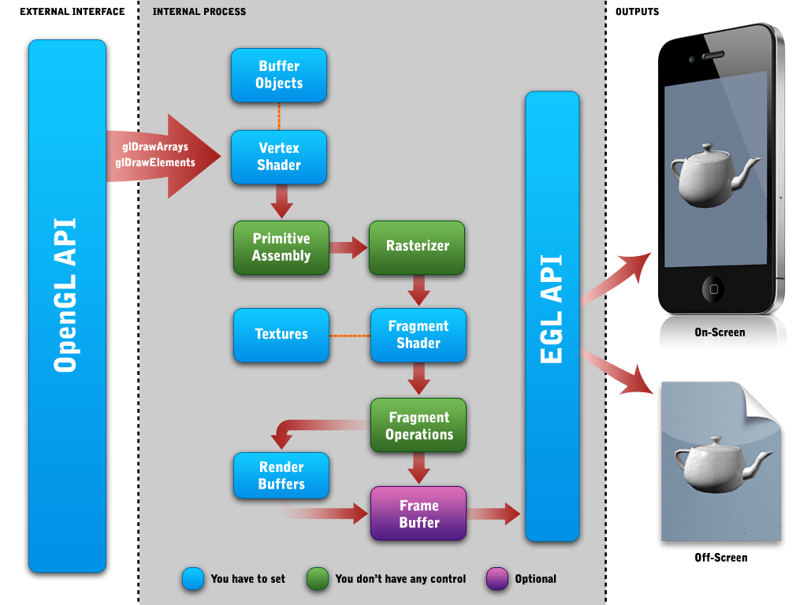


Programmable pipeline
Illustration from db-in.com
Notes:
An overview of the pipeline just to get you familiarized with som key words. I will step you trough the process on next slide.
Buffer Objects: A temporary storage that can hold information about the 3D objects in an optimized format. Structures (vertices) or indices (combinations of vertices). “server-side”
Shaders: We will look into that in a minute.
Primitives:
3D Points (x,y,z): Particles
3D Line (two points)
3D triangle (three points)
Rasterization: “Interpolation" refers to the blending of vertex attributes across the pixels.
Render Buffers: A temporary storage of one single image.
Frame Buffers: Collection of temporary images in a binary array. Color, Depth, Stencil.

Slide 37
Notes:
Whenever a pixel is drawn, it updates the z buffer with its depth value. Any new pixel must check its depth value against the z buffer value before it is drawn. Closer pixels are drawn and farther pixels are disregarded. (tx,ty) stands for texture coords.

Slide 38
Notes:
Scissor: Crop within fixed rectangle
Alpha: Reducing rasterization latency ex. <5%
Stencil: Works like a mask (Portals, guns scope, mirrors) Read and write enabled. Used with shadows.
Depth: Compares the Z depth of the current 3D object against the others Z depths previously rendered. Hidden surface removal.
Blend: Blend the new fragment with the existing fragment into the color buffer.
Stencil and depth tests read/write buffers.

Slide 39
Notes:
Some more information about Forward vs. Deferred rendering:
http://altdevblogaday.org/2011/01/18/forward-vs-deferred-rendering-whywhen-forward-rendering-still-matters/

Slide 40
Stages overview
Transformation
Display
Fragment processing
Rasterization
Viewport transformation
Clipping/Culling
Projection transformation
Primitive generation
Viewing transformation
Vertex processing
Fragment shader
Texturing
Fog
Series of tests with increasing complexity:
Post-processing
Display on screen
or readback: Render to buffer and retrieve values. Really slow!
Forward / Deferred rendering
Convert geometry into fragments
(r,g,b,a), (x,y,z,w), (tx,ty)
Interpolate vertex colors/texture coordinates over the fragment.
Each fragment has RGB color and depth value (z-buffer)
Transformations
Provide vertices and indicies as arrays and variables/constants to pipeline input.
From Clip Space to Window Space.
e.g. [-1,1] →[0,640]
Z-value retained for testing.
Don't render what we can't see
Clipping:
Remove primitives outside of the camera's view frustum
Back-face culling:
Remove triangles facing away from camera
From Camera Space to Clip Space
Orthographic or Perspective
Use frustum box
Primitive Assembling.
If geometry shader is available, new primitives can be generated.
From world space to camera space
Calculate lighting on each vertex.
Emissive + ambient + diffuse + specular → output vertex color
Vertex shader
Scissor
Alpha
Stencil
Depth
Blend
Notes:
The boxes speak for them selves, but below is some additional information for a couple of boxes.
Rasterization: Whenever a pixel is drawn, it updates the z buffer with its depth value. Any new pixel must check its depth value against the z buffer value before it is drawn. Closer pixels are drawn and farther pixels are disregarded. (tx,ty) stands for texture coords.
Fragment processing:
Scissor: Crop within fixed rectangle
Alpha: Reducing rasterization latency ex. <5%
Stencil: Works like a mask (Portals, guns scope, mirrors) Read and write enabled. Used with shadows.
Depth: Compares the Z depth of the current 3D object against the others Z depths previously rendered. Hidden surface removal.
Blend: Blend the new fragment with the existing fragment into the color buffer.
Stencil and depth tests read/write buffers.
Display: Some more information about Forward vs. Deferred rendering:
http://altdevblogaday.org/2011/01/18/forward-vs-deferred-rendering-whywhen-forward-rendering-still-matters/

Slide 41
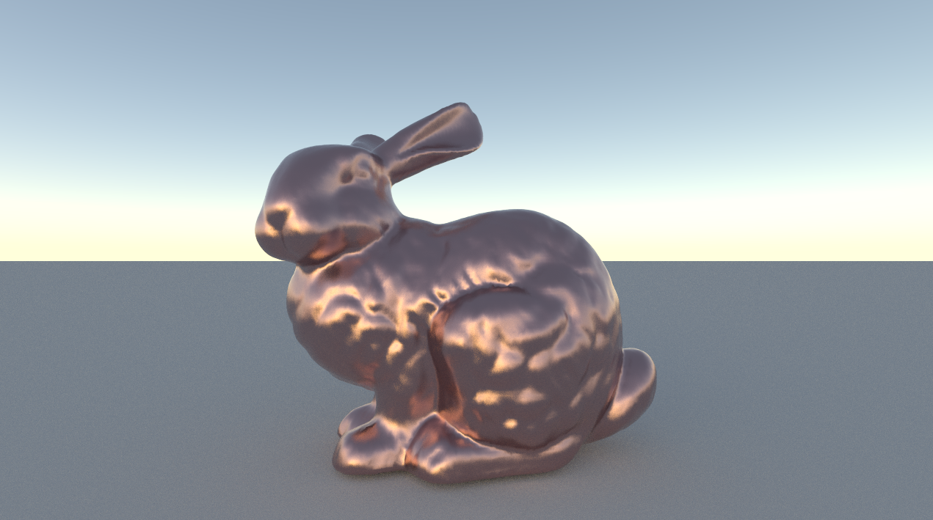
SHADERS
The method to render an object.
Notes:
Put on your shaders!

Slide 42
About shaders
Small programs that runs on the GPU.
Most shader languages are the same.
Vertex and Fragment shaders work in pairs.
The pair is compiled into a Program
Uniforms, Attributes, Varyings, Built in attributes
Notes:
The Uniforms (constants) are always constant and can be used in both shaders kind.
Attributes: You can define attributes only into VSH (per-vertex values).
Varyings are used for passing data from a vertex shader to a fragment shader. Interpolated.
Built in attributes like gl_ModelViewMatrix or gl_Vertex. (OpenGL)

Slide 43
Low level shading language
Assembly language
ARB (GPU)
AGAL (Adobe Graphics Assembly Language)
!!ARBfp1.0
TEMP color;
MUL color, fragment.texcoord[0].y, 2.0;
ADD color, 1.0, -color;
ABS color, color;
ADD result.color, 1.0, -color;
MOV result.color.a, 1.0;
Notes:
Ehh... Next slide please!

Slide 44
High level shading languages
HLSL – DirectX API
Cg – NVIDIA
GLSL – OpenGL
ShaderLab – Unity3D
PixelBender3D – Molehill
HxSL – haXe Shader
Notes:
There are three main languages that are used to write these real time shaders:
HLSL, which can be used with the DirectX API;
Cg, which was created by NVIDIA; The Cg compiler outputs DirectX or OpenGL shader programs. Cg is more like HLSL for OpenGL.
GLSL, which is part of the new version 2.0 of the OpenGL standard.

Slide 45
Vertex shader
VS or VSH
Executed at each vertex
Transform between coordinate systems
Lighting
Defines the final position of that vertex
Outputs some variables to the Fragment shader.

Slide 46
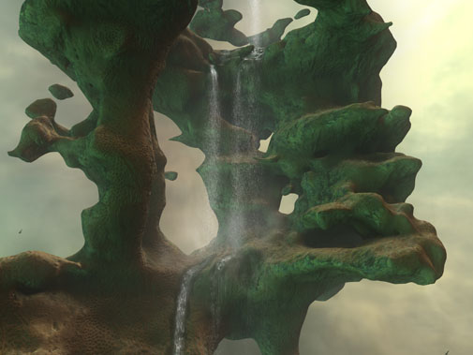
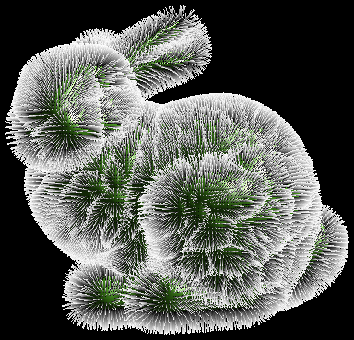
Geometry Shader
Dynamic creation of geometry on the GPU
Only Shader Model 4.0
Direct3D 10, OpenGL 3.2
Not available in OpenGL ES 2.0 (Molehill, webGL)
Notes:
A geometry shader can generate new graphics primitives, such as points, lines, and triangles, from those primitives that were sent to the beginning of the graphics pipeline
Physical simulations creation
Procedural generation
Instancing

Slide 47
Fragment Shader
FSH
Processed at each visible fragment
Fragment != Pixel
Handles bump effects, shadows and lights, reflections, refractions, textures, ray casting and other effects.
Output is a pixel color in the format RGBA
Notes:
fragment !=pixel, can be less or more in final image when stretched.

Slide 48
Texture objects
Texels
Power of Two (POT) 2, 4,…512, 1024 pixels
Flipped pixel order (OpenGL)
Integer/Floating-point
Notes:
Pixels of the texture commonly called "texels“
Mipmaps: These are pre-shrunk versions of the full-sized image. Of course, needs more memory.
When sampling a texture, the implementation will automatically select which mipmap to use based on the viewing angle, size of texture, and various other factors.

Slide 49
Texture Filtering
Fixing artifacts
Texture magnification/minification
Mipmapping
Different techniques:
Nearest-neighbor interpolation
Nearest-neighbor with mipmapping
Bilinear filtering
Trilinear filtering
Anisotropic filtering
Notes:
Texture magnification: The texels are larger than screen pixels.
Texture minification: The opposite
Mipmapping: Prefiltered textures in smaller resolution. “Shortcuts” to avoid expensive calculations when determinating the average color of multiple textels.
Nearest-neighbor interpolation: fastest and crudest filtering method, large number of artifacts - texture 'blockiness' during magnification, and aliasing and shimmering during minification.
Nearest-neighbor with mipmapping: adds mipmapping — first the nearest mipmap level is chosen according to distance, then the nearest texel center is sampled to get the pixel color. This reduces the aliasing and shimmering significantly, but does not help with blockiness.
Bilinear filtering: four nearest texels to the pixel center are sampled (at the closest mipmap level), colors are combined and weighted average according to distance. Removes the 'blockiness' seen during magnification.
Trilinear filtering: fixing artifact seen in mipmapped bilinearly filtered images. Texture lookup and bilinear filtering on the two closest mipmap levels (one higher and one lower quality), and then linearly interpolating the results.
Anisotropic filtering: highest quality. Anisotropic filtering corrects blurriness by sampling in the correct trapezoid shape according to view angle. The resulting samples are then trilinearly filtered to generate the final color. http://www.extremetech.com/article2/0,1558,1152380,00.asp
Read more: http://en.wikipedia.org/wiki/Texture_filtering

Slide 50
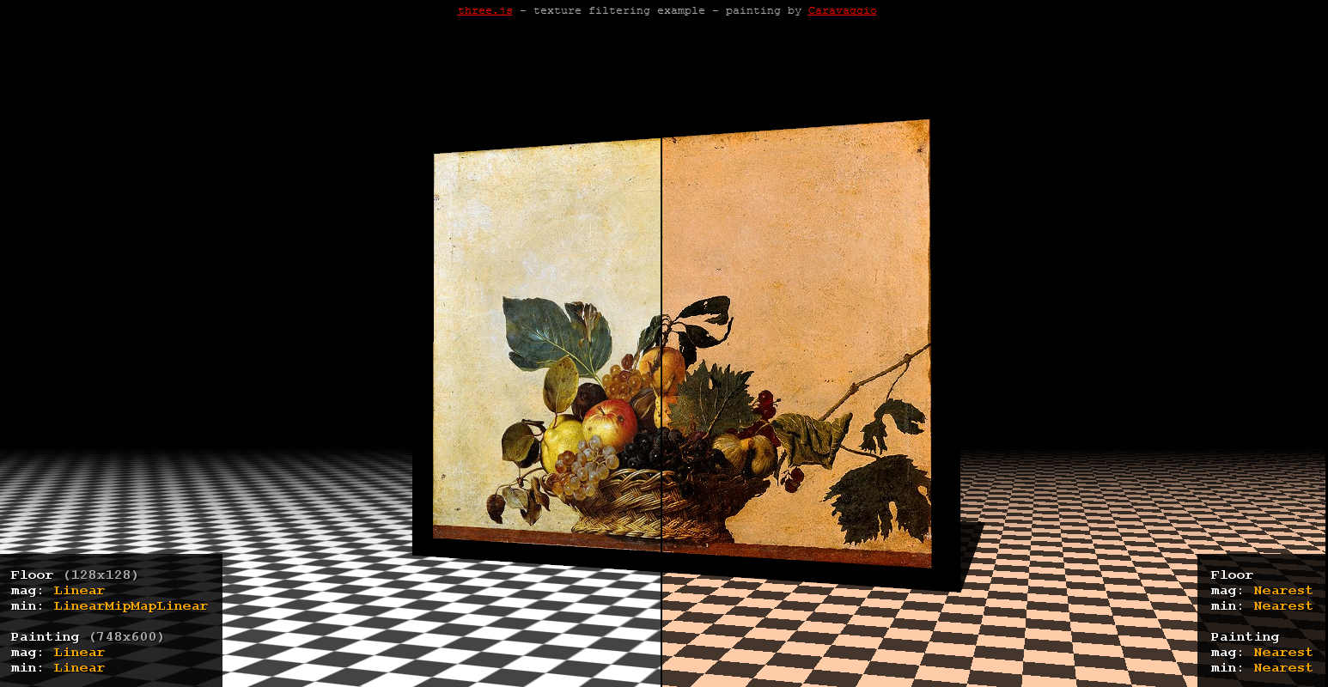

Let’s have a look at the WegGL implementation (click on image)
three.js
Notes:
http://mrdoob.github.com/three.js/examples/webgl_materials_texture_filters.html

Slide 51
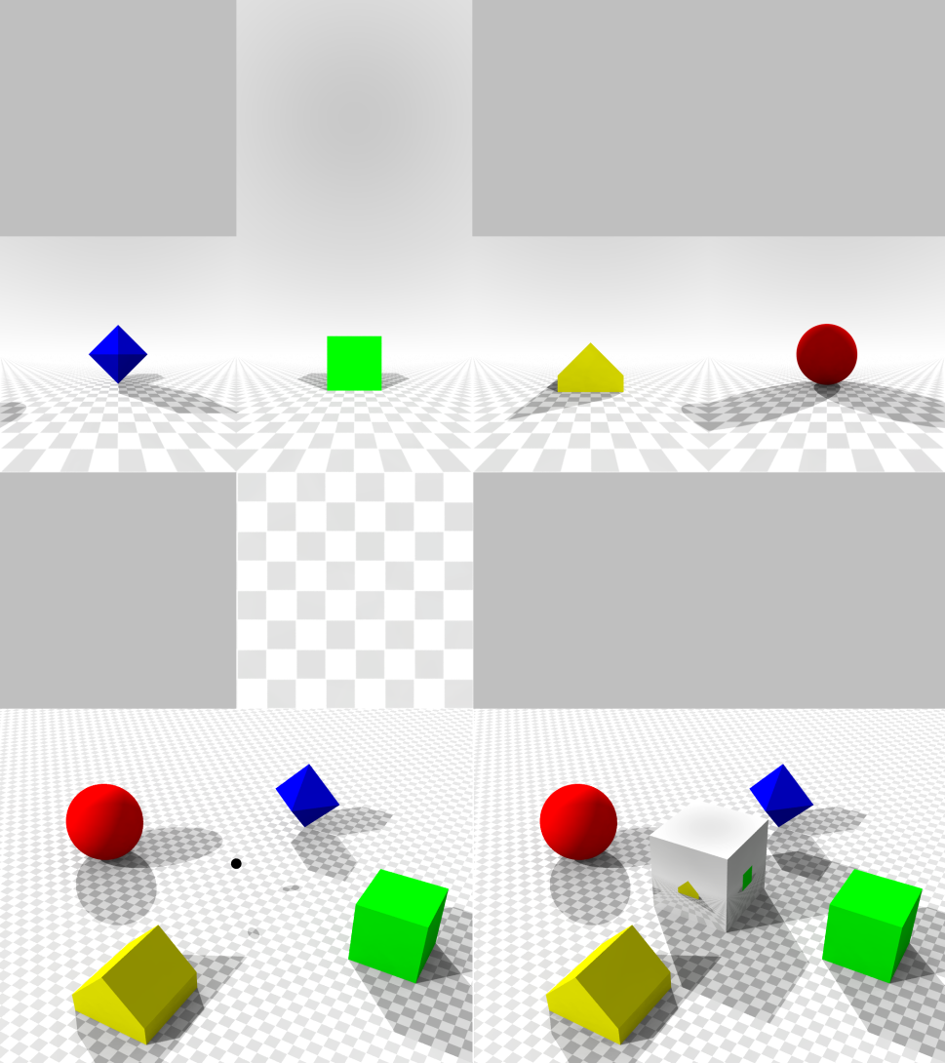
Cubemap texture
3D texture
Skybox
Reflections
Environment map
Notes:
Collection of six separate squares
Textures that are put onto the faces of an imaginary cube.

Slide 52
Shader tool examples
Shader Toy – WebGL
MeShade – WebGL
PixelBender3D – Molehill
Node Based Shader Editor – Unity3D

Slide 53
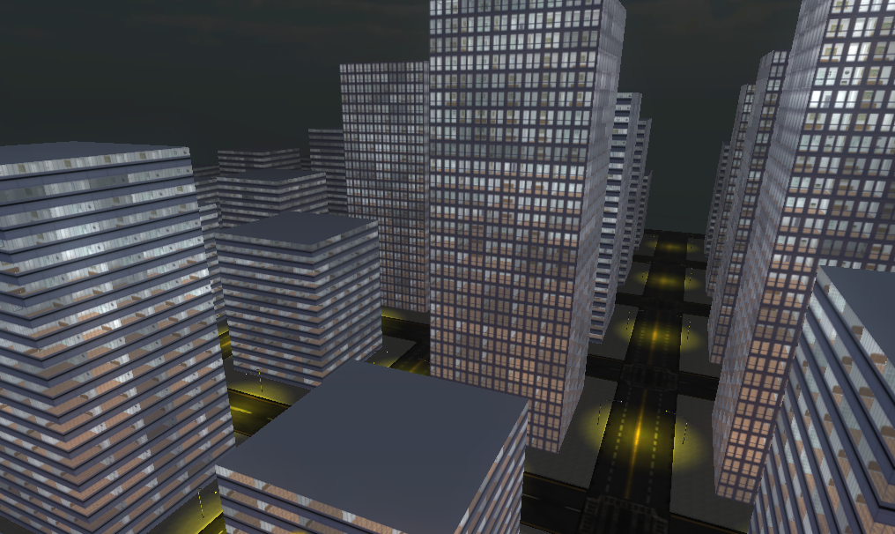

Interior mapping
DEMO
DEMO
Notes:
In this demo I show my first try with shaders. We go through the source and I explain a little more about each part. Other subjects I talk about is for example Ray-casting, Texture Filtering, Procedural content, Lighting, Sky boxes, Materials, Perlin noise and Fog. It’s all there!
http://inear.se/city/demo1

Slide 54
Animations, Skin and Bones
Tweens
Animation controllers Blending Mixing/Additive
Vertex animations in shader
Procedurally animating
Notes:
Just touching the subject. It’s very specific for the actual framework how it’s implemented. Both Unity and Away3D have built in support for animation controllers.

Slide 55
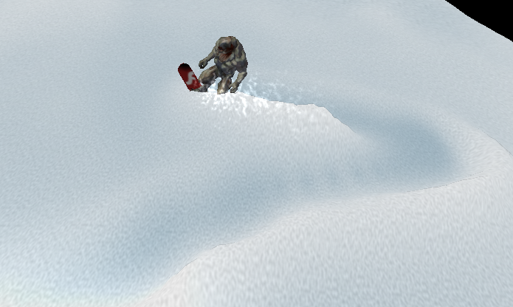
Animations in Away3D Broomstick
DEMO
DEMO
Notes:
Experiment of mine using bones and animation controller in Away3D Broomstick, vertex displacement and ”texture coordinate transform”. This demo require Flash Player 11 (incubator-build), with support for molehill. Can be downloaded here: http://labs.adobe.com/downloads/flashplatformruntimes_incubator.html
http://www.inear.se/offpiste/demo4

Slide 56
Materials
Material is the collection of properties applied to an object.
Shaders is the implemention. ”The code”
In Unity, think that materials is a collection of exposed properties of the shader.

Slide 57
Some ingredients:
Color
Diffuse: base color
Ambient: color of ambient light (shadowed parts). Mostly the same as diffuse.
Specular: Highlight color
Emissive: Glow. Overrides shadows.
Alpha: Transparency
Texture (2D,Cubemap)
Shininess: size of specular highlights (gloss)
Reflection/Refraction
Bump-mapping: height, grayscaled image
Normal-mapping: Dot3 bump mapping, xyz->rgb
Paralax-mapping: height + direction, graycaled+rgb
Notes:
A lot of text I now, but there is a lot of parameters.
Emissive color is similar to ambient color, except that it does not require that any light be in the picture.

Slide 58
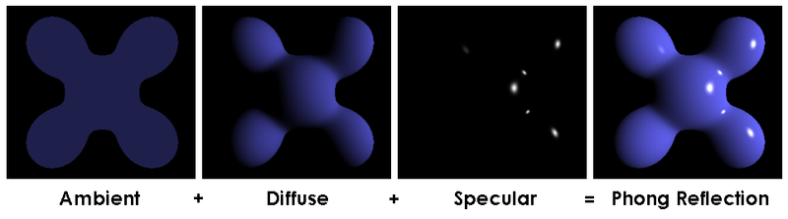
Example
Notes:
A picture from wikipedia to show the combination of some of the parameters.

Slide 59

Unitys Normal Shader Family
VertexLit
Diffuse
Normal mapped
Specular
Normal Mapped Specular
Parallax Normal mapped
Parallax Normal Mapped Specular
Notes:
In expensive order.
http://unity3d.com/support/documentation/Components/shader-NormalFamily.html

Slide 60
Lighting
Uses normals
Directional/point-lights
Material settings to decide final color.
Lighting is computed at each vertex.
Light mapping (beast)
Deferred shading
Notes:
You must specify normals, or generate them automatically, along with your geometry.
You can obtain more correct lighting with a higher surface approximation, or by using light maps.

Slide 61
Lambert shading
Gouraud
Phong
Notes:
Phong uses interpolated normals on each pixel. Gouraud only uses normals on each vertex when calculating the light on each triangle.

Slide 62
Real-time shadows
PLANE PROJECTION SHADOWS
Flattened objects/imposters on planar surfaces
Fast but unrealistic
No self-shadows
SHADOW VOLUMES
Computationally heavy
Using stencil buffer or texture
DEPTH SHADOW MAPPING
VERTEX PROJECTION
Soft shadows: average map pixels
Hard shadows: nearest map pixel
Hardware
Self shadowing
Like plane projection but with calculated silluette.
High detail
Self-shadowing
Notes:
Realtime shadows are cool, but needs some time to calculate. There is different techniques with different performance. See what kind of shadows available in your framework of choice.
Stencil buffer: The basic algorithm is to calculate a "shadow volume". Cull the back faces of the shadow volume and render the front faces into the stencil buffer while inverting the stencil values. The data left is the shadowed parts.
WebGl-demo: http://gomo.se/webgl/webgl_stencilLensFlare.html
Read more:
http://www.devmaster.net/articles/shadows/
http://en.wikipedia.org/wiki/Shadow_volume

Slide 63
Quality and performance
Non realtime-shadows fastest!
Shadow map resolution
Number of lights
Notes:
For many lights and complex scenes, read more about Deferred shading: Complex lights, g-buffer, incorrect anti-aliasing, Advanced scenes, not supporting transparency: http://en.wikipedia.org/wiki/Deferred_shading

Slide 64
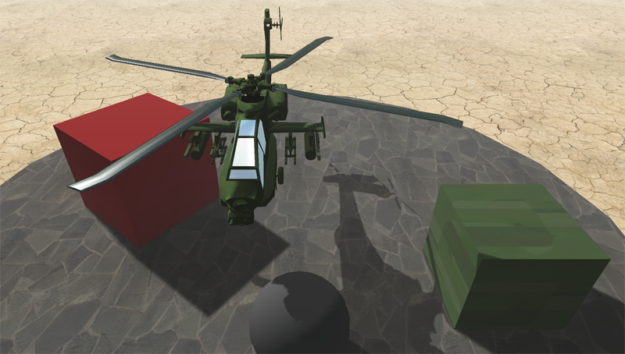

Example in Unity
DEMO
DEMO
Notes:
Demo of shadows in Unity3D. Turn on and off lightmapping and realtime shadows (depth shadow mapping) . See the difference with soft/hard shadows.
http://inear.se/slide_demos/shadows2/
Read more: http://www.peroxide.dk/papers/realtimesoftshadows.pdf

Slide 65
Special effects
Effects
Color correction
Postprocessing stage / GPU
LDR/HDR, Tone mapping
Notes:
LDR = Low Dynamic Range
HDR = High Dynamic Range

Slide 66
Bloom
Depth of field
Sun Shafts
SSAO
Blur
Noise
Notes:
Some examples of effects applyed to the hole screen. You can, as with Depth Of Field, use the depth-buffer here as well.
SSAO = Screen Space Ambient Occlusion = Post process image fx. Depth map-based diffuse shading http://www.fuelyourmotionography.com/ambient-occlusion/

Slide 67

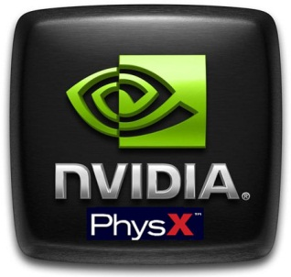
Physics
Notes:
Just saying there is physics enginges in 3D-frameworks. I don’t dig deeper than that for now.

Slide 68
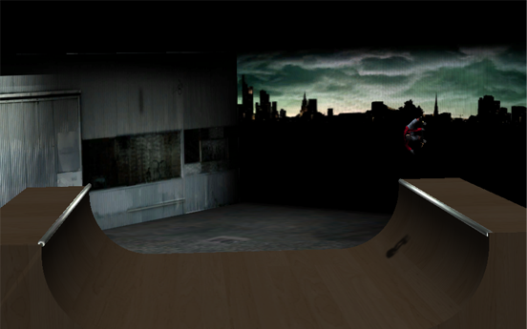
Very simple physics demo
DEMO
DEMO
Notes:
An excellent opportunity to show of a little demo I made to try the physics-engine. The rider has a ”dummie-ball” that slides on the ramp. To gain speed I add a force to the ball in the right position.
http://inear.se/slide_demos/skate/

Slide 69





Frameworks
Goal: Games, experimental, Vizualisation?
Reach: Plugin? Multiple platforms/screens?
Cost: Open source? Licenced?
Support: Large community?
Notes:
All these frameworks. It can be hard to choose a way when the choice is free and totally up to you. Think wide, and don’t paint yourself into a corner. Try out as many frameworks you can if you don’t have a clue. I have selected three possible paths for you to have a look at. Unity3D, Flash and WebGL. Flash is a collection of different high-level-frameworks. I focus on the biggest open-source one: Away3D.

Slide 71
Unity3D
Boo, C# and JavaScript
Plugin
Great and simple IDE
Competent and mature framework
Pro version to get all goodies
Multiple screens/targets
Future: Export to flash/molehill
Notes:
The export to flash is quite interesting. Programming c# and exporting to flash? Wonder what features will be available. It will certainly effect the choice between wegGL and Molehill on the online 3D scene.

Slide 73
Flash/Molehill
Actionscript
Plugin
3D content always under the DisplayList
All the other stuff in the flash player.
Molehill currently in alpha

Slide 74
Flash 3D Engines
Engine | Licence/Price | link
Away3D 4.0 | Open source, free | »
Flare3D 2.0 | Licence, price unknown | »
Aerys Minko | No licence, just consulting | »
Sophie 3D | Licence, 329£ (3000 kr) | »
CopperCube 2.5 | Licence, 99£, professional 300£ | »
Zest3D | Open source, free | »
Alternativa 8 | Licence, price unknown | »
ND2D Molehill 2D Engine | Free | »
Mandreel | 3000 £ (26000 kr) | »

Slide 75
Optimizing
Profiling memory usage, cleanup/destroy
Object Pooling! polygonal lab
Take control of rendering pipeline
Compression/Model to ByteArray
AWD, Away3Ds own format (Prefab)
Trends of resource-load in online 3D?
Optimize opcodes in swf: http://www.buraks.com/azoth/

Slide 77
WebGL
Javascript
No plugin
Open / Royalty-free
Not available in all browsers yet
Frameworks in early states
Probably available on iOS soon

Slide 78
WebGL Frameworks
GLGE
Canvas 3D JS Library
CopperLicht
EnergizeGL
SpiderGL
Three.js
OSG.JS
O3D
Notes:
http://www.khronos.org/webgl/wiki/User_Contributions#Frameworks

Slide 79

Jellyfish
DEMO
DEMO
Aleksandar Rodic
Notes:
http://aleksandarrodic.com/p/jellyfish/

Slide 80

Particles
DEMO
DEMO
alteredqualia.com
Notes:
http://alteredqualia.com/three/examples/particles_sprites_gl.html

Slide 81

Hello Racer
DEMO
DEMO
HelloEnjoy™
Notes:
http://helloracer.com/webgl/

Slide 82

Clouds
DEMO
DEMO
Mr Doob
Notes:
http://mrdoob.com/lab/javascript/webgl/clouds

Slide 83
WebGL vs. Molehill APIs
HTML5 vs. Plugin.
WebGL will probably run in iOS browser.
Easy to port between them.
Once it running on the GPU, performance is hardware related regardless of API.
It is the high level frameworks that makes the difference.

Slide 84
Debugging
Profiling CPU
FlashPreloadProfiler
Profiling GPU
Pix for windows
Intel® Graphics Performance Analyzers (GPA)
Notes:
Links:
FlashPreloadProfiler
Pix for windows
Intel® Graphics Performance Analyzers (GPA)

Slide 85
3D Model filetypes
Format | Ext | Away3D | Unity3D | Dynamic
Actionscript | .AS | x
Autodesk® FBX® | .FBX (MAX) |  | x | x
Wavefront | .OBJ | x | x
Collada | .DAE | x | x | x
Quake 2 | .MD2 | x | x | x
Quake 3 | .MD5 | x | x | x
3ds Max object | .3DS | x | x
Away 3D | .AWD | x |  | x

Slide 86
Learning tips
Try some tutorials with Molehill API or WebGL to get an understanding of the pipeline
Read, follow, blog, get interested!
Pay attention to techniques outside your own field. SIGGRAPH, GPU gems, Nvidia.
Get familiar with existing work. We’ll get there eventually.
Port code
from another
language.
Tech is one thing, art is another. Good artwork is what makes it successful in the end.
Stand on the
shoulders of
giants.

Slide 87
Random interesting topics
Notes:
I have to set some form of limitation on how much we will cover in this presention. Following slides just put the words out there for you to look up by yourself. Please let me know if you think of a obvious topic to mention here.

Slide 88
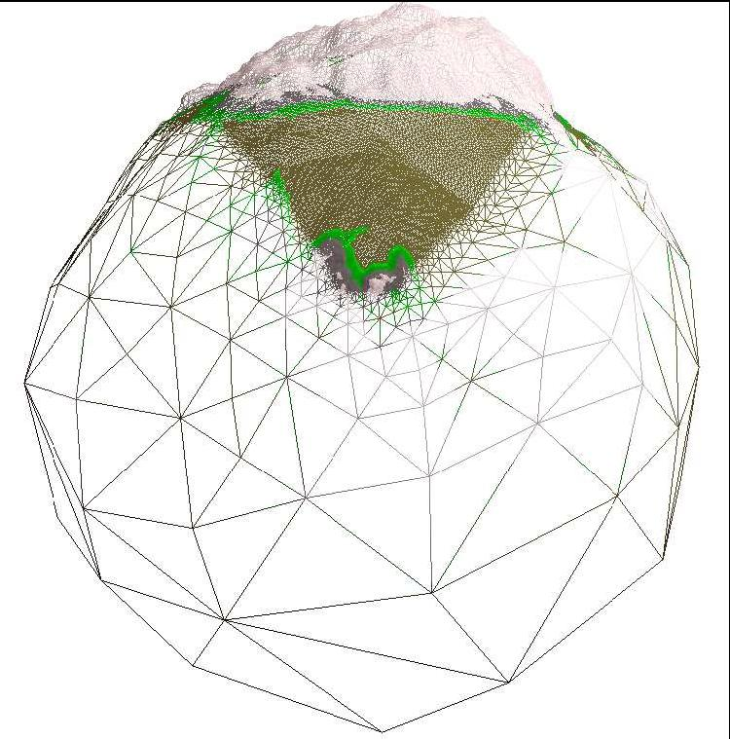
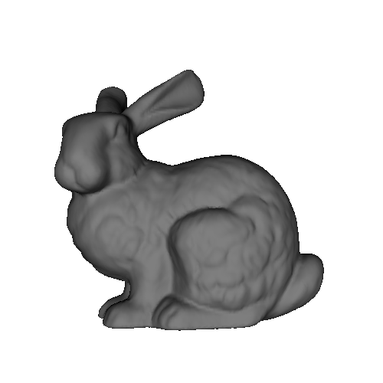

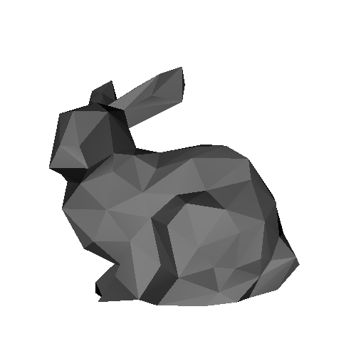
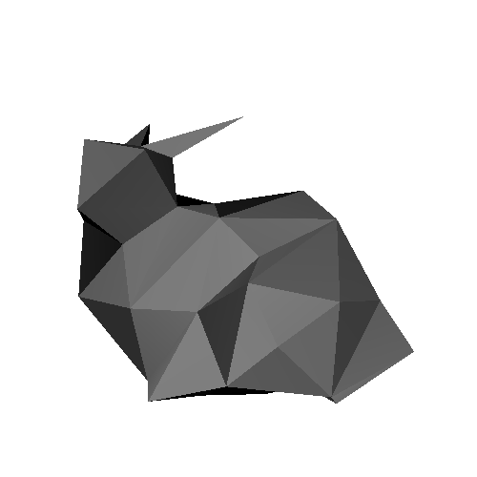
Random interesting topics
Level of detail
Notes:
http://en.wikipedia.org/wiki/Level_of_detail
Supported in Away3D. (LODObject )
ROAM terrain

Slide 89
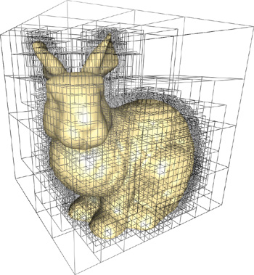
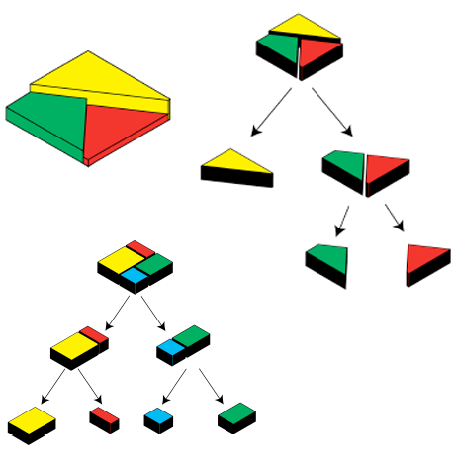
Random interesting topics
Octree, BSP Tree, Portals and Sectors
Notes:
http://http.developer.nvidia.com/GPUGems2/gpugems2_chapter37.html
Binary Space Partitioning
http://www.derschmale.com/2010/04/22/bsppvs-released-in-away-3-5-0/

Slide 90



Random interesting topics
Global illumination / Ambient occlusion
Notes:
http://www.fuelyourmotionography.com/ambient-occlusion/

Slide 91
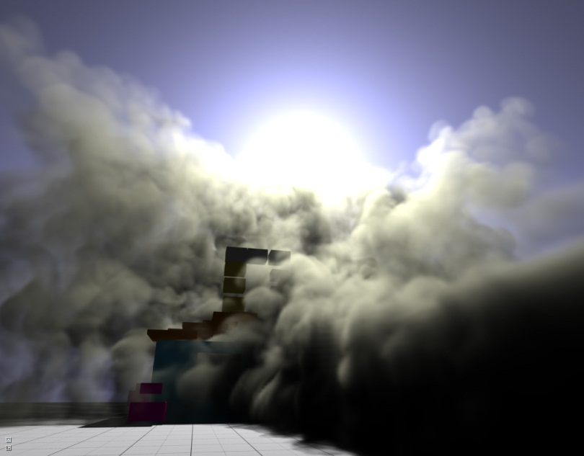
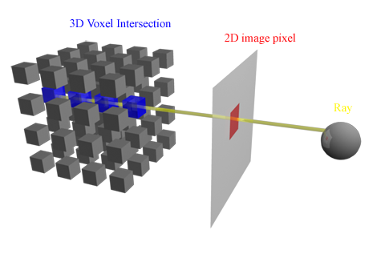
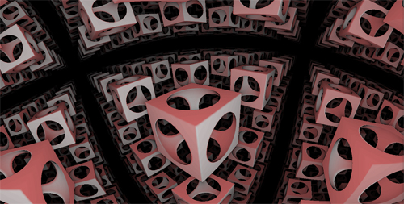
Random interesting topics
Raytracing/Raycasting/Raymarching
Notes:
http://cg.alexandra.dk/tag/ray-marching/

Slide 92
Some useful resources
COMPUTER GRAPHICS
SIGGRAPH papers: http://kesen.realtimerendering.com/
OpenGL / WebGL
OpenGL resources: http://www.opengl.org/
Game programming community: http://www.gamedev.net/
OpenGl tutorial: http://db-in.com/blog/2011/01/all-about-opengl-es-2-x-part-13/
ShaderToy WebGL http://www.iquilezles.org/apps/shadertoy/
Fractal Lab: http://fractal.io/
CG tutorial: http://http.developer.nvidia.com/CgTutorial/cg_tutorial_chapter01.html
FLASH
Away3D 3.6 Tutorials: http://www.flashmagazine.com/Tutorials/category/3d/
Creative coding podcast: http://creativecodingpodcast.com/
GEEKS3D: http://www.geeks3d.com/
Miles Macklins Blog: https://mmack.wordpress.com/
GAMEDEV: http://www.gamedev.net/index
ModelViewMatrix explained: http://db-in.com/blog/2011/04/cameras-on-opengl-es-2-x/
Teaching machines: http://www.twodee.org/blog/
Video tutorials: http://www.3dbuzz.com/vbforum/content.php?176
UNITY
Pix GPU profiling: http://msdn.microsoft.com/en-us/library/ee417072(v=VS.85).aspx
TOOLS
Slides about Zombie Tycoon: http://molehill.zombietycoon.com/FGSZombieNoVideos.pptx
Demystifying molehill: http://www.rictus.com/muchado/2011/02/28/demystifying-molehill-part-1/
Molehill demos: http://tinyurl.com/molehilldemos
Molehill resources: http://www.uza.lt/2011/02/27/molehill-roundup/
Digging into Molehill API: http://www.bytearray.org/?p=2555
Molehill getting started: http://labs.jam3.ca/2011/03/molehill-getting-started/
3d vs. flash tips: http://blog.bengarney.com/2010/11/01/tips-for-flash-developers-looking-at-hardware-3d/
MOLEHILL
Notes:
COMPUTER GRAPHICS
SIGGRAPH papers: http://kesen.realtimerendering.com/
GEEKS3D: http://www.geeks3d.com/
Miles Macklins Blog: https://mmack.wordpress.com/
GAMEDEV: http://www.gamedev.net/index
Teaching machines: http://www.twodee.org/blog/
OpenGL / WebGL
OpenGL resources: http://www.opengl.org/
Game programming community: http://www.gamedev.net/
OpenGl tutorial: http://db-in.com/blog/2011/01/all-about-opengl-es-2-x-part-13/
ShaderToy WebGL http://www.iquilezles.org/apps/shadertoy/
Fractal Lab: http://fractal.io/
CG tutorial: http://http.developer.nvidia.com/CgTutorial/cg_tutorial_chapter01.html
ModelViewMatrix explained: http://db-in.com/blog/2011/04/cameras-on-opengl-es-2-x/
FLASH
Away3D 3.6 Tutorials: http://www.flashmagazine.com/Tutorials/category/3d/
Creative coding podcast: http://creativecodingpodcast.com/
MOLEHILL
3d vs. flash tips: http://blog.bengarney.com/2010/11/01/tips-for-flash-developers-looking-at-hardware-3d/
Molehill getting started: http://labs.jam3.ca/2011/03/molehill-getting-started/
Digging into Molehill API: http://www.bytearray.org/?p=2555
Molehill resources: http://www.uza.lt/2011/02/27/molehill-roundup/
Molehill demos: http://tinyurl.com/molehilldemos
Demystifying molehill: http://www.rictus.com/muchado/2011/02/28/demystifying-molehill-part-1/
Slides about Zombie Tycoon: http://molehill.zombietycoon.com/FGSZombieNoVideos.pptx
TOOLS
Pix GPU profiling: http://msdn.microsoft.com/en-us/library/ee417072(v=VS.85).aspx
UNITY
Video tutorials: http://www.3dbuzz.com/vbforum/content.php?176

Slide 93
Books and papers
Away3D 3.6 essentials
Mathematics for Game Developer by Christopher Tremblay
Mathematics for 3D Game Programming and Computer Graphics by Eric Lengyel
Game Graphics Programming by Allen Sherrod
Realtime shadows
Raycasting in GPU shaders by Joost van Dongen

Slide 94
Thanks!
Wow! You made it all the way here! I hope you got inspired to continue your journey into the third dimension. Thanks for listening!
www.inear.se
twitter.com/inear
Notes:
www.inear.se
twitter.com/inear

